Slide 1
Grant writing 101
The road to your ideas taking flight

Slide 2
Building Mighty Communities
Todd Mandel, Principal
14 years of grant-writing experience
Grew Couleecap’s housing rehabilitation work from a $300,000/year operation to a $2,000,000/year operation
Served six years on the Federal Home Loan Bank Community Investment Advisory Council overseeing $23 million in grants annually
Grew economic programming from $15,000/year to $100,000+/year
Assisted VCMS with securing funding for the 54656 podcast
http://mightycommunities.com
www.facebook.com/mightycommunities

Slide 3
What’s Your Idea?
Find a partner you don’t know. In pairs, discuss your idea and what you think you might need to make it happen
Who wants to share?
Grants almost always go to 501(c)(3) non-profits. Sometimes can go to individuals. Rarely go to for-profit businesses.
For-profits usually need non-profit partner

Slide 4
What’s the most important?
What do you think is the most important?
Your Story / Idea?
Following the grant application rules?
Discuss
It’s a trick question: they are EQUAL

Slide 5
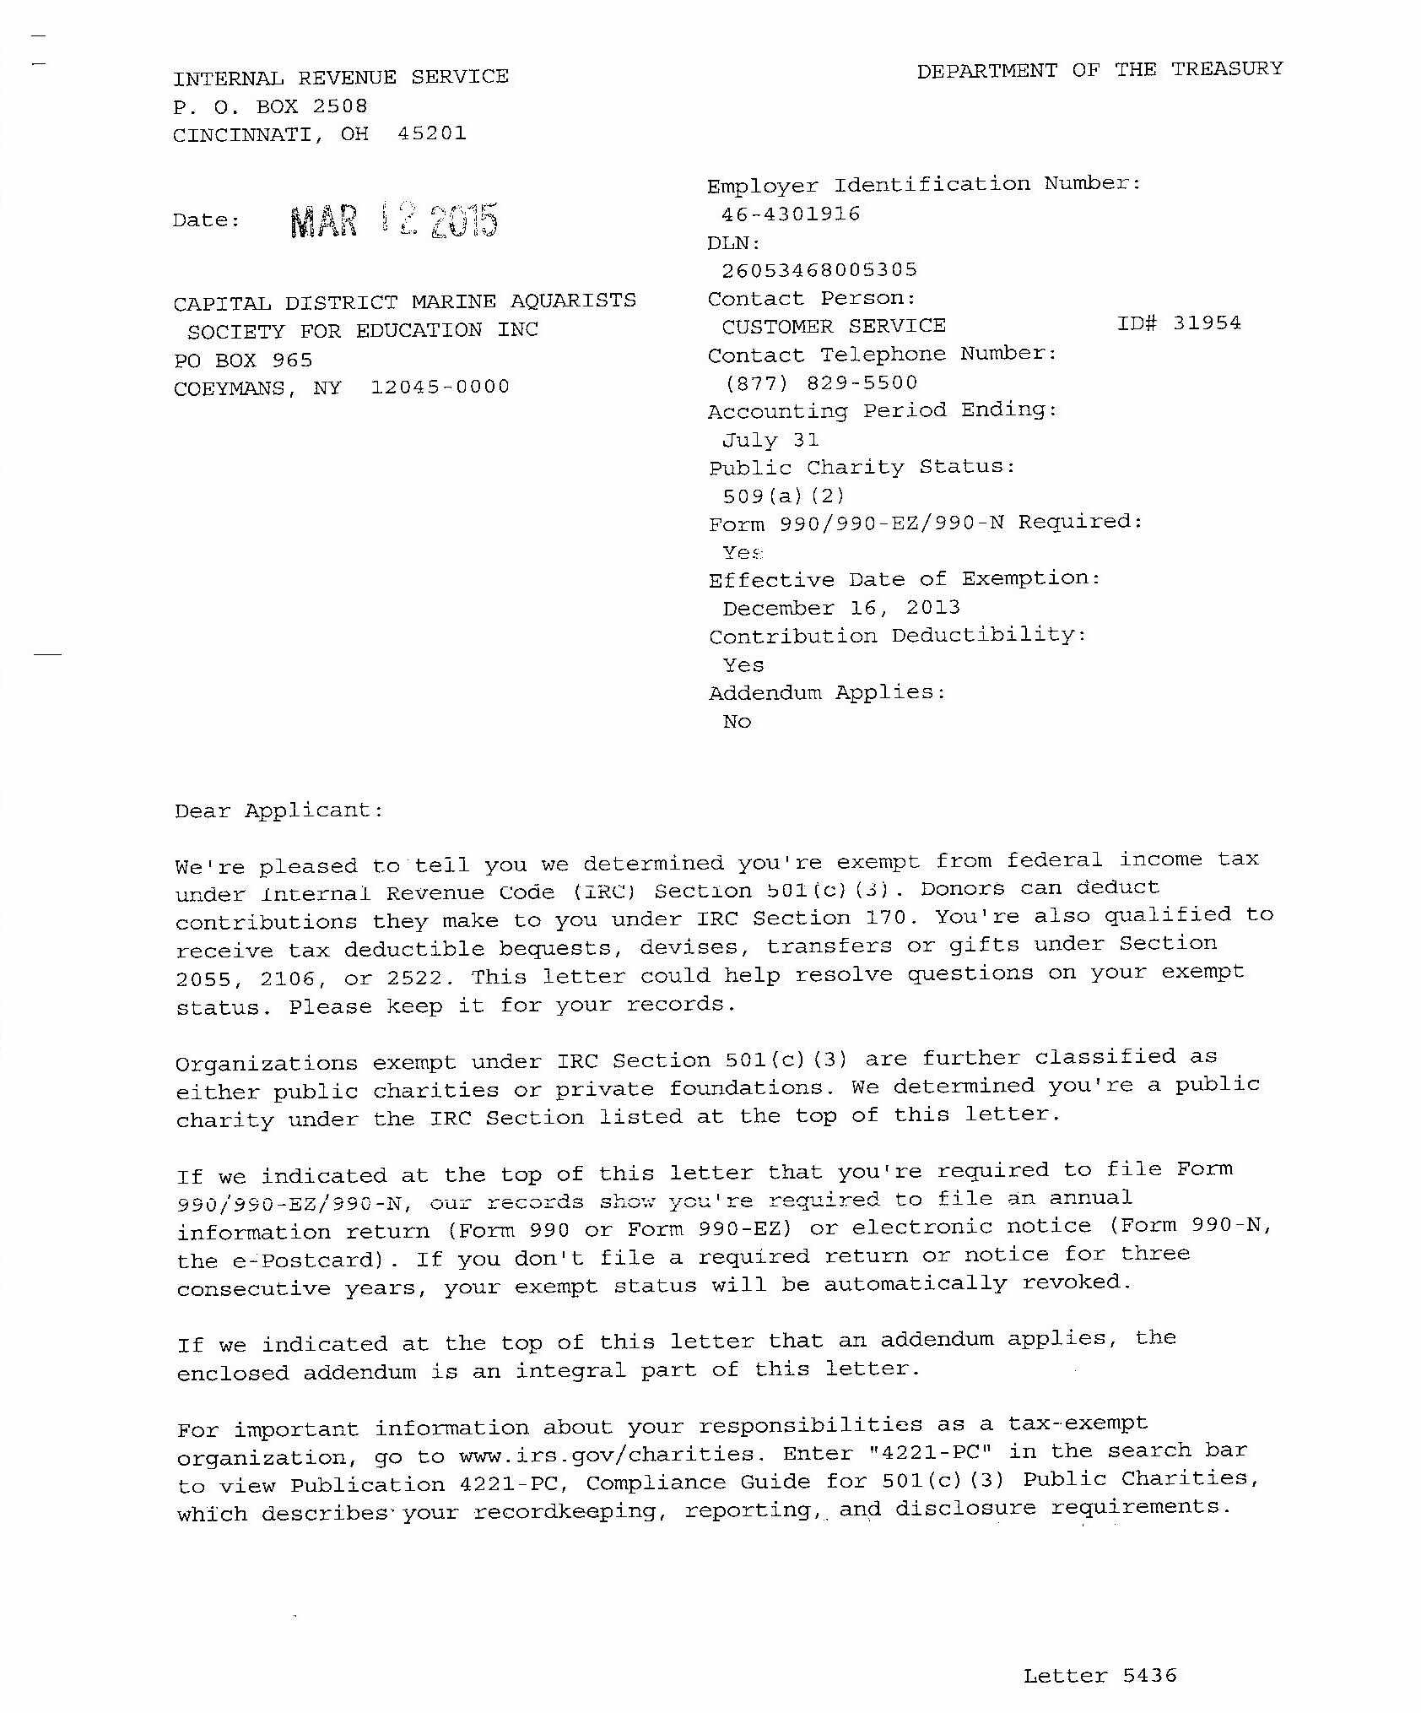
Getting Started
First Steps
Establish a “Documents File”
Locate your organization’s 501(c)(3) letter from the IRS
Don’t have it? You can request an affirmation letter from the IRS.
https://www.irs.gov/charities-non-profits/exempt-organizations-affirmation-letters

Slide 6
Getting Started
More basic information to gather:
List of Board of Directors with affiliations
Annual operating budget
Non-discrimination policy. Don’t have one? Have your board pass one (see sample handout)
By-laws
Articles of Incorporation
Don’t have them? You can get a certified copy from the Wisconsin Dept of Financial Institutions
Certificate of Status (formerly Certificate of Good Standing)
Certificates and Articles can be obtained at https://www.wdfi.org/corporations/fees/cert_program_inst.htm
Cost for each is $10.00.

Slide 7
Simon Sinek TED Talk
https://www.ted.com/talks/simon_sinek_how_great_leaders_inspire_action?language=en

Slide 8
The Unmet Need
Grants are ultimately about solving an unmet need
You need data to prove the need
HUD datasets
Census datasets
Unemployment data
Policy Map (https://www.policymap.com/maps)
Data specific to your need
Needs to be from a reputable source

Slide 9
The Plan
The Narrative
A powerful story
Start with Why
https://www.ted.com/talks/simon_sinek_how_great_leaders_inspire_action?language=en
Who: Your Team
Backgrounds and relevant experience
Where: Geographic service area
When: Timeline.
Partners: Find partners at the start, not at application time
Money partners
Resource partners
Feel-good partners
What:
Objectives with measurable outcomes
Methodology to reach the outcomes

Slide 10
Exercise
Take your Awesome Idea Sheet
Set two relevant and attainable goals
Fill in your team and some relevant experiences
Identify potential partners
Identify where this work will take place
Identify a timeline. Does this timeline work with your goals?

Slide 11
Make a Budget
Don’t overthink the budget
Are you getting paid? Who is getting paid? Benefits? Fiscal sponsor?
The bigger the grant, the more detailed to budget… to a point
Things commonly overlooked:
Rent: office space, program space, etc.
Utilities
Communications: Do you need internet? Phone? PO Box?
Supplies vs. Equipment
Legal

Slide 12
Budgeting
Make sure your budget timeline matches your grant timeline and your goals timeline
Matching Funds: Directly spent or contributed to the project. Federal funds cannot match other federal funds unless specifically designated.
Cash. Example: Vernon County contributed $2,000 to your project.
In-Kind. Example: Organic Valley provides office space, valued at $1,500 for a year, to the project.
Leveraging funds: Funds spent indirectly on the project.
Federal funds from another source spent on your federally funded project
Example: Federal grant specifies that construction costs cannot be used as matching dollars. However, someone builds a $300,000 shelter house for your project, that house would be reportable as leveraging. It can’t be reported as match because the grant rules specifically say construction costs are a disallowed use.
More details available in the OMB Uniform Guidance (2014)
Aka the OMB “Supercircular”

Slide 13
Talk to Partners & People
Meet with potential partners in advance of a grant opportunity
Get them excited
Talk about potential support, partnerships, and contributions
The time to start talking is not when a grant opportunity is first released! The short timelines don’t allow true relationship building!

Slide 14
Find an Opportunity
Four major categories of grants:
Local/Regional Foundation
State/National/Interest Area Foundation
Local/State Government
Federal Government

Slide 15
Local / Regional Foundations
Smaller dollar amount & Community-focused
Connections are important
Viroqua Area Foundation
http://www.viroquaareafoundation.org/
Community Foundation of Southwest Wisconsin.
Aggregated source of many small community-focused funds
https://www.cfsw.org/grants/open-grant-applications/
La Crosse Community Foundation
https://www.laxcommfoundation.com/
Educational Foundations
Directly support district programming
Likely need to partner with the district or a school
Southwest Minnesota Foundation

Slide 16
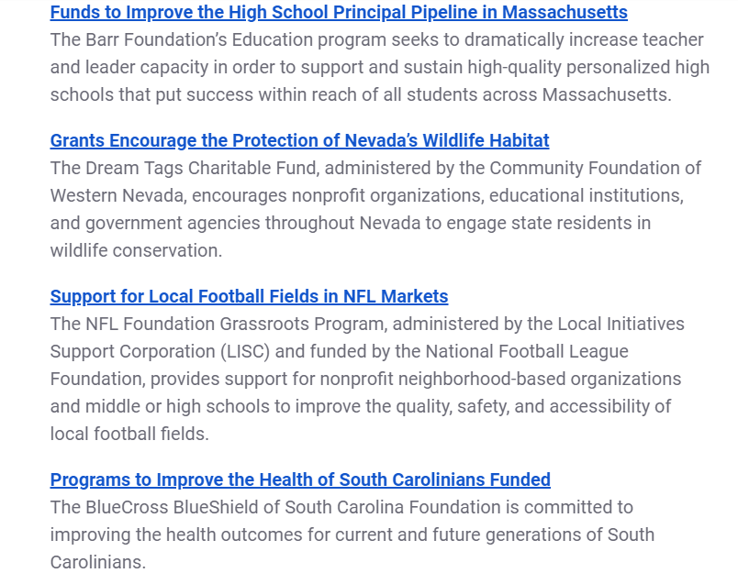
State/National/Interest Area Foundations
Larger competitive area
Often tied to specific geography
Places where corporations have a footprint
Very specific interest areas
Often have large, favored non-profits
Minimizes the contracts
Tend to invest in critical-need areas / maximize impact
Connections are important
Often need an invitation to apply

Slide 17
Local / State Government
Local / County Government
Strict geographic restriction (assignment of funds)
Limited funding
Is it federal, but run through a local office?
If so, all the federal rules come along with it
Understand the source: TIF, Federal pass-through, tribal, etc
State Government
Very interest focused
Tourism, Small Business Development
Brownfields
Job Training
Run by the departments that oversee the interest area

Slide 18
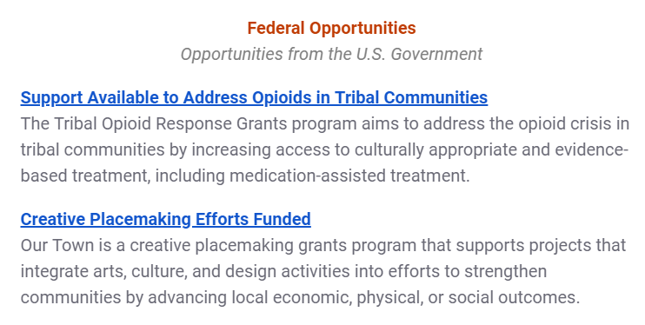
Federal Government
Typically very specific
Can be found via the Federal Register
Complex and demanding
Typically large $$ amounts
Usually need to prove capacity to manage
Self-capacity
Partner with someone
Hire a consultant
Highly competitive
Often data-dependent to determine need

Slide 19
10 Ways to Handcuff Your Grant Application
Not allowing time to write
Proposals submitted three or more days before the deadline have a 37% greater chance of funding. Missing a deadline means disqualification.
Not paying attention to instructions
50% of federal grant applications are eliminated because directions are not followed
Poor Writing
Avoid acronyms, watch grammar, and use spellcheck.
Failure to edit
Lack of data to prove the need
Lack of experience in the field
Lack of experience in grants management
Limited number of partners
Have a professional read over your entire proposal. Use a grant writer at a partner agency or hire an independent grant writer.
Lack of match. Usually need firm commitment letters.
No realistic plan for sustainability.
Partner with an experienced non-profit or hire a consultant.

Slide 20
A Few Words on Sustainability
Funders today want to see programs that project “sustainability”
If your effort is a one-off effort, say that
If you see your effort continuing past the funding end date; how do you plan to do that?
The plan should not involve coming back to the same funder for constant infusions.
How will you address the need without your funder someday?
Some Sustainability Strategies
Make your effort a “proof of concept” that you can then shop to other funders.
Use funder money as “seed capital” for some type of social entrepreneurism (selling something to make money).
Use grant to discover how much you can charge for service as a form of revenue.
“Hiring your way into sustainability” is not popular with funders

Slide 21
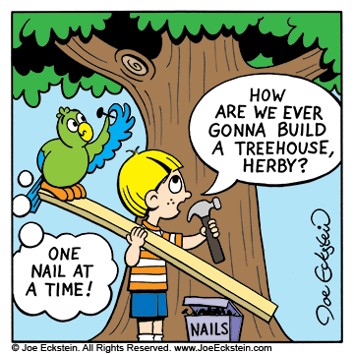
Final Wrap Up
Lots of opportunities, but also lots of competition!
Multiple ways to get a grant done:
Do it yourself
Partner with another agency
Hire a grant writer
A few tips on hiring a grant writer:
Never hire one that works on receiving a percentage of the grant funding
Ask to see their work portfolio
Ask up-front to understand their pricing
Insist on a written contract and written delegations of work / responsibility
You may need to apply a few times to get the grant you want. Persevere!
If it’s worth doing; it’s worth doing right!

